Slide 1
IBM Applied Data Science Capstone Project The competition of restaurants by district in Bangkok
Kitithat Pansang March 31, 2021

Slide 2
Business Problem
How fierce is the competition for restaurants in Bang Wa subdistrict?
Should you choose to open a Japanese or Thai restaurant near Bang Wa subdistrict?

Slide 3
Data Acquisition
The 5o Districts and 180 Subdistricts of Bangkok which can be obtained from Wiki page “Khwaeng”.
Geospatial of each location can use GeoPy package to get latitude and longitude base on subdistricts name.
The Foursquare API was used to add venue data for the neighborhoods such as number of restaurants, category, etc.

Slide 4
Methodology
Data Loading: Scrapping subdistrict name from the Wikipedia, and search for geological by using GeoPy python package.
Venue Data from FourSquare API: The FourSquare API was called for data of each rastuarant around geological of subdistrict
Data Cleaning: Grouping category that same nationality such as sushi restaurant, Japanese restaurant or Udon Restausrant to Japanese.
Rank Order Venue: Creating a table indicating the order of the number of 10 descending stores in each region.
Modeling: Performed K-Means clustering to find patterns in locations
Visualize: Clusters in Folium map

Slide 5
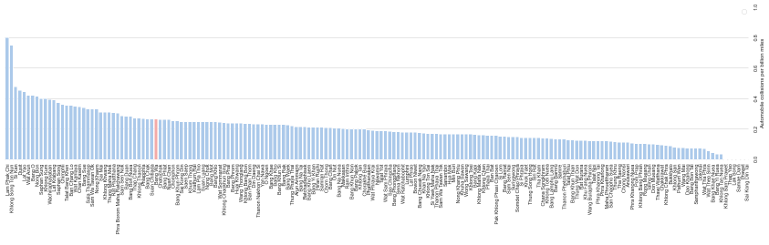
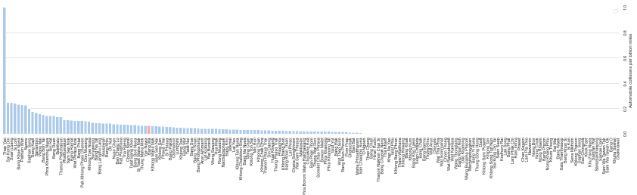
Results
Thai restaurants
Japanese restaurants look more interest than Thai restaurants in our sub-district, Bang Wa.
“Less competitive”
Japanese restaurants

Slide 6
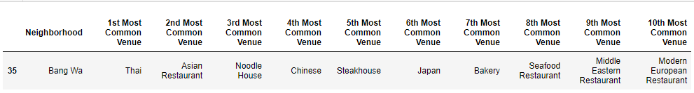

Results
Thai restaurants
“Confirm with ranking of each categories of restaurant in Bang Wa district.”

Slide 7
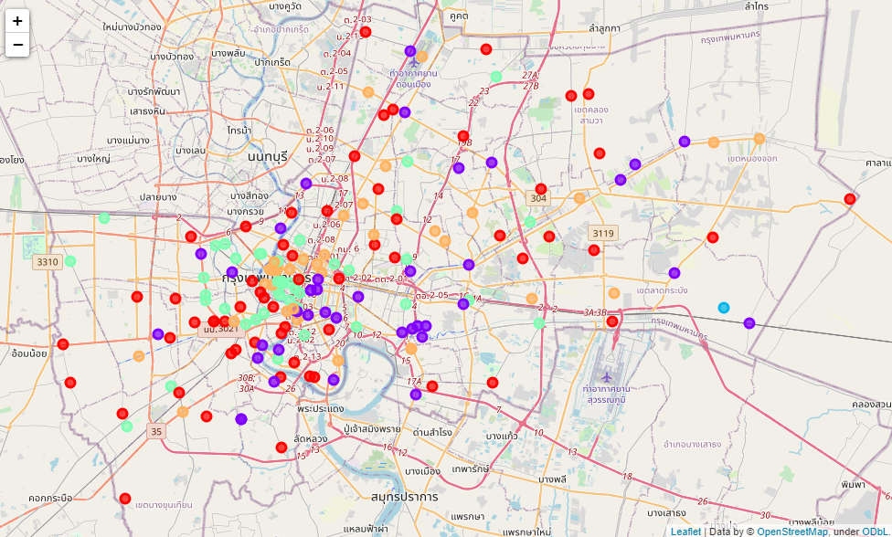
Results
Cluster was found to have dispersed of each group throughout Bangkok.
Next restaurant, find similar subdistrict!!

Slide 8




Thank you!

